Slide 1
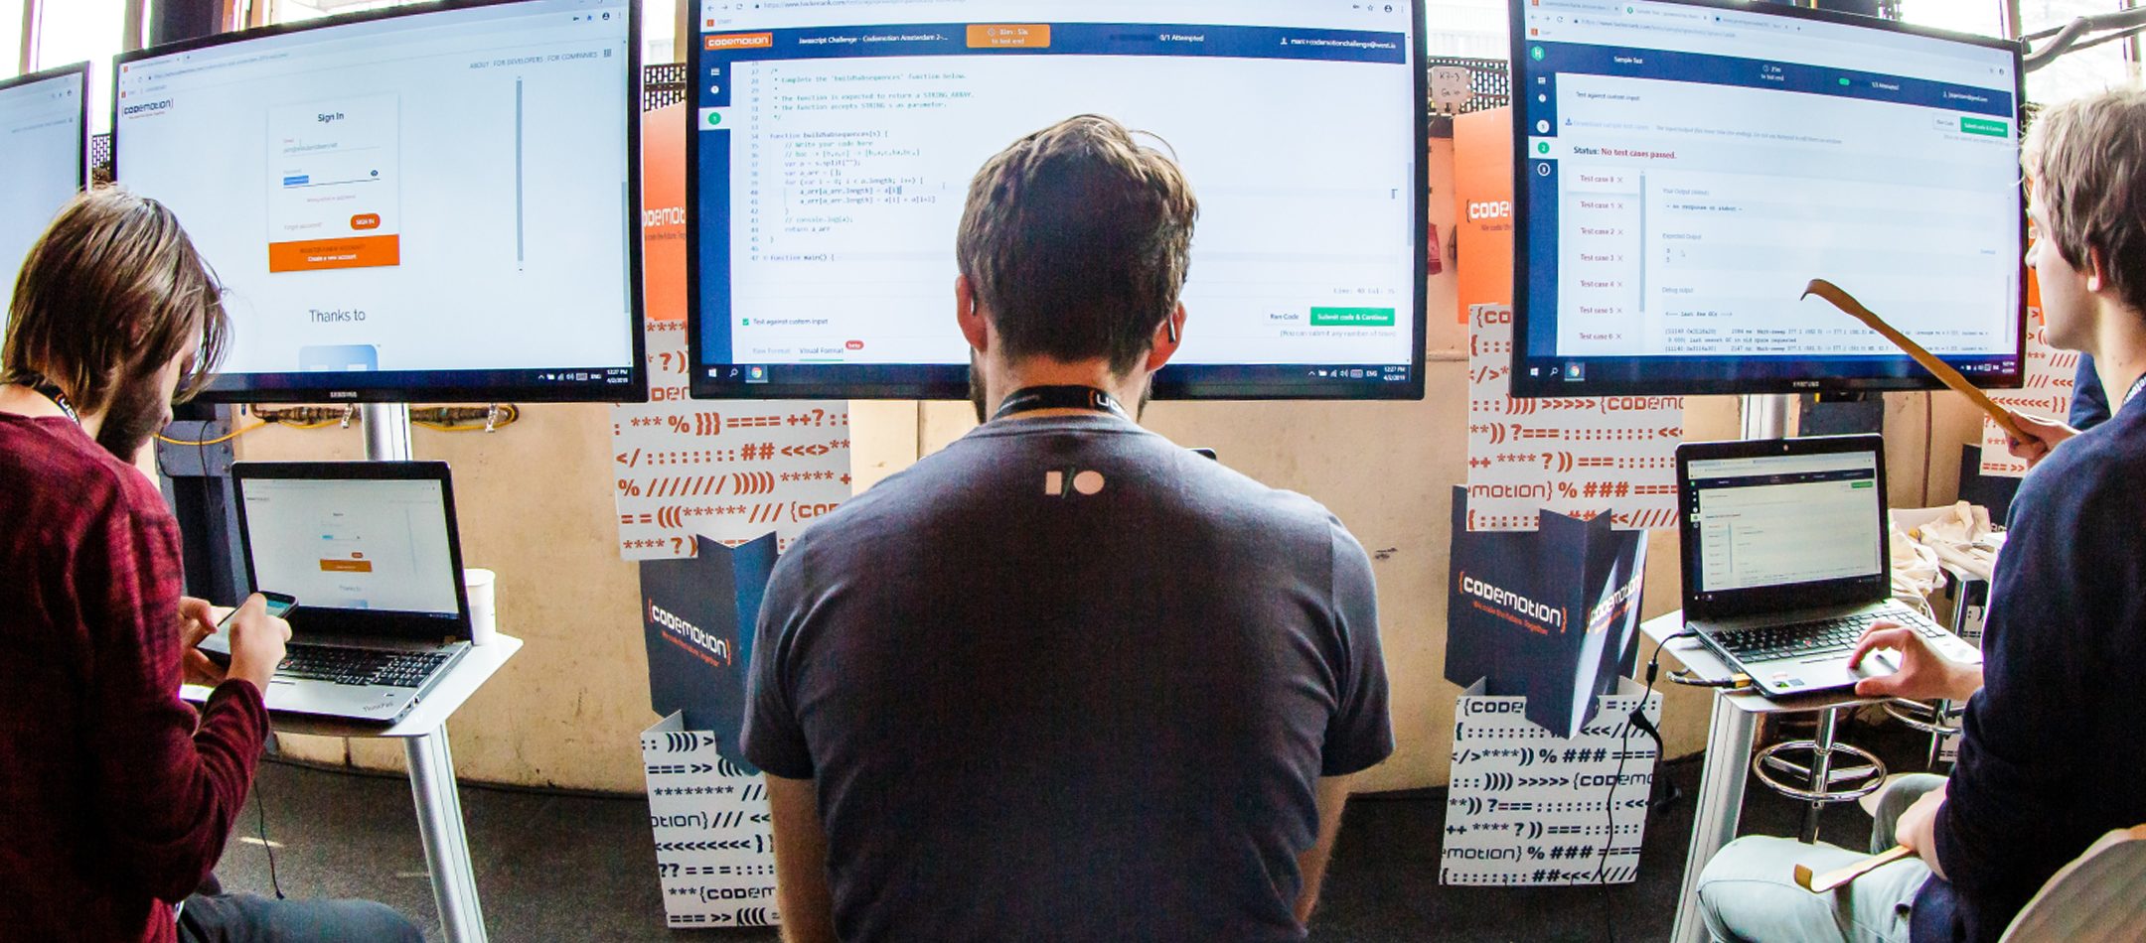


OpenTelemetry for microservices applications
Andrea Tosato - Software Architect (HUDI srl)
9-10-11 Novembre, 2021

Slide 2


Slide 3
Why observability?
Microservices create complex interactions.
Failures don't exactly repeat.
Debugging multi-tenancy is painful.
Monitoring no longer can help us.

Slide 4
Telemetry aids observability
Telemetry data isn't observability itself.
Instrumentation code is how we get telemetry.
Telemetry data can include traces, logs, and/or metrics.
All different views into the same underlying truth.

Slide 5
Metrics, logs, and traces, oh my!
https://opentelemetry.io/status
Metrics
Aggregated summary statistics.
Logs
Detailed debugging information emitted by processes.
Distributed Tracing
Provides insights into the full lifecycles, aka traces of requests to a system, allowing you to pinpoint failures and performance issues.
Structured data can be transmuted into any of these!

Slide 6
Tracing concepts in a nutshell
Span
Represents a single unit of work in a system.
Typically encapsulates: operation name, a start and finish timestamp, the parent span identifier, the span identifier, and context items.
Trace
Defined implicitly by its spans. A trace can be thought of as a directed acyclic graph of spans where the edges between spans are defined as parent/child relationships.
DistributedContext
Contains the tracing identifiers, tags, and options that are propagated from parent to child spans

Slide 7
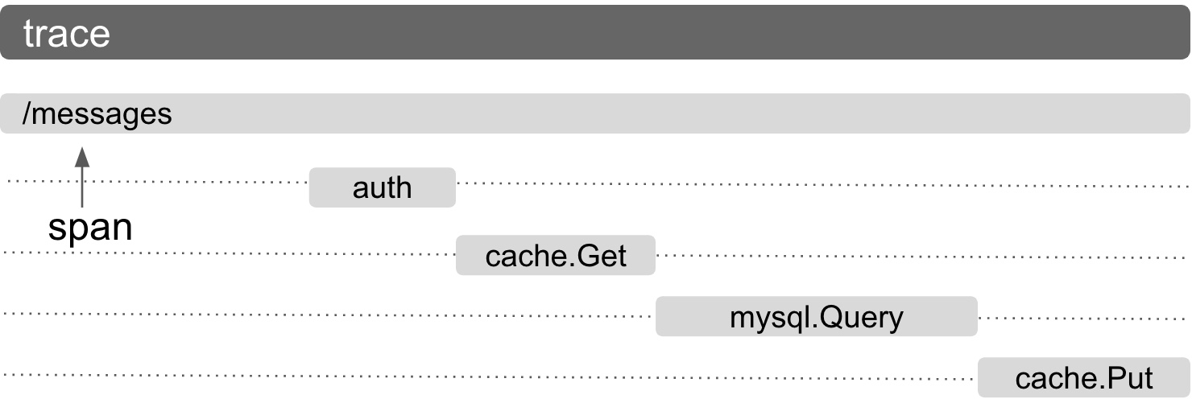
Tracing concepts in a nutshell

Slide 8
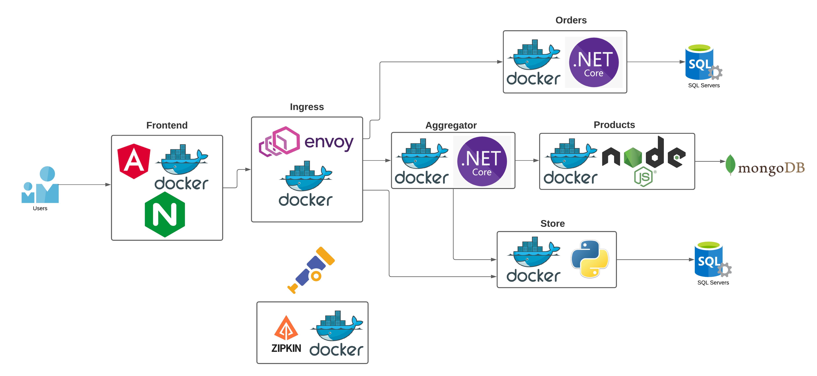
Our lab architecture

Slide 9
https://github.com/andreatosato/Codemotion-2021-11

Slide 10

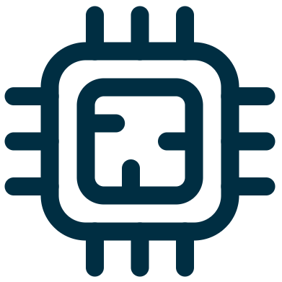

OpenTelemetryCollector - Component
Receiver
Processor
Exporter

